Slide 1
Non-relational data stores for Ruby
Overview, coding and assessment:
MongoDB, Tokyo Tyrant & CouchDB github.com/igal/ruby_datastores
Igal Koshevoy, Pragmaticraft
Business-Technology Consultant
igal@pragmaticraft.com
@igalko on Twitter & Identi.ca

Slide 2
Terminology
Key-value store: Hash-like struct, often mapping a string key to a string value, e.g., Berkely DB, memcached, etc
Document-oriented DB: Hash-like struct, typically mapping key to arbitrary columns, e.g., Lotus Notes, CouchDB, etc
Relational database: Set of rigidly-defined tables, rows and columns, e.g., PostgreSQL, MySQL, etc.

Slide 3
Why non-relational?
Improve:
Speed
Flexibility
Reliability
Scalability
Eliminate:
Table schemas
Constraints
Transactions
Locks

Slide 4
Non-relational coding patterns
Denormalization to reduce finds/queries:
  Calculations
  Foreign keys
  Foreign values
Schema versions per object
Incremental migrations
Namespace based relations
Sharding data

Slide 5
MongoDB
http://mongodb.org/
A 10gen project under GNU AGPL v3.0
Document-oriented
Pros
General purpose
Quick
Scalable: master-slaves
Resilient: replica pair
Many datatypes
Multiple indexes
Sophisticated queries
Many atomic operations
Cons
Not transactional
Not ACID

Slide 6
MongoDB (cont)
require 'mongo'
# Connect.
db = XGen::Mongo::Driver::Mongo.new("localhost", 27017).db("mydb")
# Get a collection.
collection = db.collection("mycollection")
# Add an index.
collection.create_index("number")
# Insert an item.
collection << { :number => 1, :message => "Hello" }
# Retrieve an item.
p collection.find_first(:number => 1)
# Query items.
p collection.find(:message => /ello/).to_a

Slide 7
Tokyo Cabinet + Tyrant
http://tokyocabinet.sourceforge.net/
A mixi.jp project under GNU LGPL v2.1
Key-value, document-oriented & other engines
Pros
Specialized engines
Very fast
Scalable: master-slaves
Resilient: dual master
Multiple indexes
Can do transactions
memcache-compatible API
Cons
Fewer features
Strings only
Simplistic queries

Slide 8
Tokyo Cabinet + Tyrant (cont)
require 'rufus/tokyo/tyrant'
# Connect.
db = Rufus::Tokyo::TyrantTable.new('localhost', 1978)
# Insert an item.
db["foo"] = { "number" => "1", "message" => "Hello" }
# Retrieve an item.
p db["foo"]
# Query items.
p db.query do |q|
q.add_condition("message", :includes, "ello")
q.limit(5)
end

Slide 9
CouchDB
http://couchdb.apache.org/
An Apache project under Apache License 2.0
Document-oriented
Pros
Very scalable: multi-master
MVCC
ACID
Versioned documents
REST
Sophisticated queries
Map-Reduce
Cons
Very, very, very slow
Must create views
Harder to use than others

Slide 10
CouchDB (cont)
require 'couchrest'
# Connect.
db = CouchRest.database!("http://127.0.0.1:5984/couchrest-test")
# Insert an item.
db.save_doc("_id" => "foo", "number" => 1, "message" => "Hello")
# Retrieve an item.
p db.get("foo")

Slide 11
CouchDB (cont)
# ...continued from last slide
# Add an view.
db.delete_doc db.get("_design/queries") rescue nil
db.save_doc({
"_id" => "_design/queries",
:views => {
:by_number => {
:map => "function(doc) {
if (doc.number) {
emit(doc.number, doc);
}
}"
}
}
})
# Query items.
p db.view("queries/by_number", :key => 1)["rows"].map{|row| row["value"]}

Slide 12
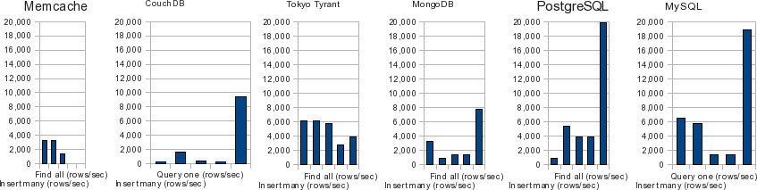
Naive benchmarks
Columns in graphs, left to right:
Insert one
Insert many
Retrieve one
Query one
Find all
Above benchmarks are naive: They use serial operations in tight loops with small datasets from single host to localhost, rather than concurrent mixture across many clients & servers with much data.

Slide 13
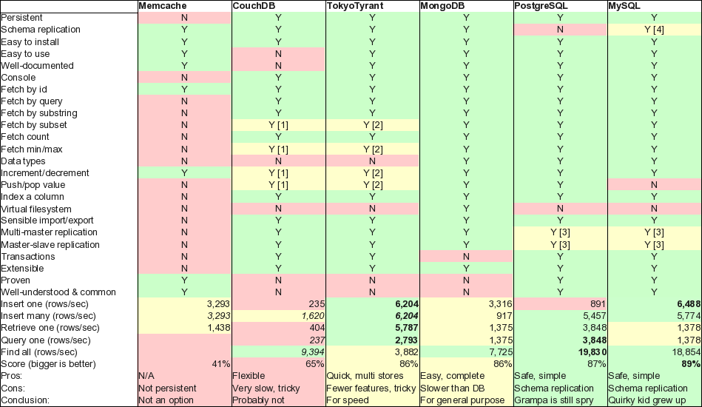

Slide 14
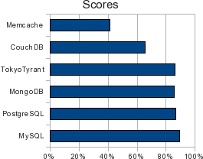

Slide 15
Conclusions
Non-relational databases have shown their worth at huge sites when used cleverly.
Non-relational databases will continue to improve performance, stability & features.
Relational databases are still a great choice: fast, powerful and proven. With caching, denormalization & rework (e.g. Drizzle) they will continue to be competitive.
Tokyo Tyrant & MongoDB are useful now as fast non-relational data stores. CouchDB has much promise, but is too slow currently for most uses.

